Slide 1
CHANGES SEEN IN A PERSON BEFORE AND AFTER JOINING THE GYM.
Using tools:-
Descriptive statistics
Correlation by CORREL function
z- test for two sample mean
Charts (by frequency function, countif function)

Slide 2
GOOGLE FORM LINK-
https://docs.google.com/forms/d/1y5vT3BH6uzroK1fHs5T6V6cBoMXXOA9cS06PKfhvEic/edit
STEPS OF GOOGLE FORM-
SEARCH GOOGLE FORM IN GOOGLE.
OPEN THE FIRST LINK AND THEN CLICK IN “GO TO FORMS”.
SELECT ANY TEMPLATE WHICH YOU WANT OR YOU CAN START A NEW FORM AND ADD QUESTIONS.
YOU CAN ALSO CHANGE THE TYPE OF ANSWERS.
AFTER THIS CLICK ON THE SEND BUTTON PRESENT ON THE TOP RIGHT SIDE OF THE SCREEN AND THEN SELECT THE SENDING OPTIONS FOR EXAMPLE GOOGLE FORMS CAN BE SHARED THROUGH LINK AND MAIL.

Slide 3
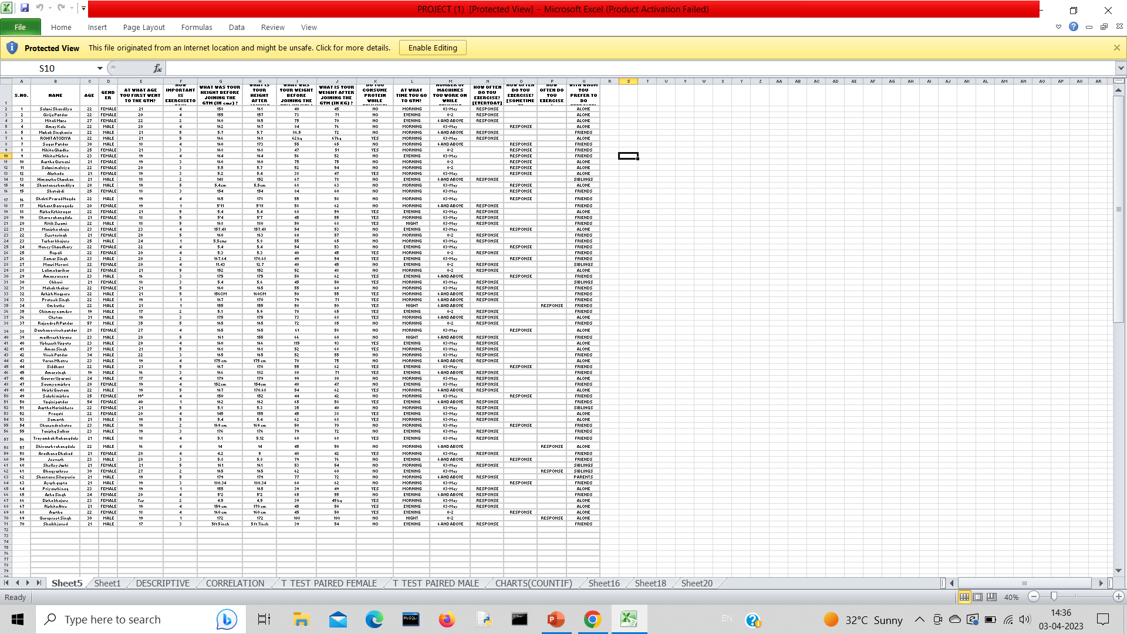

Slide 4
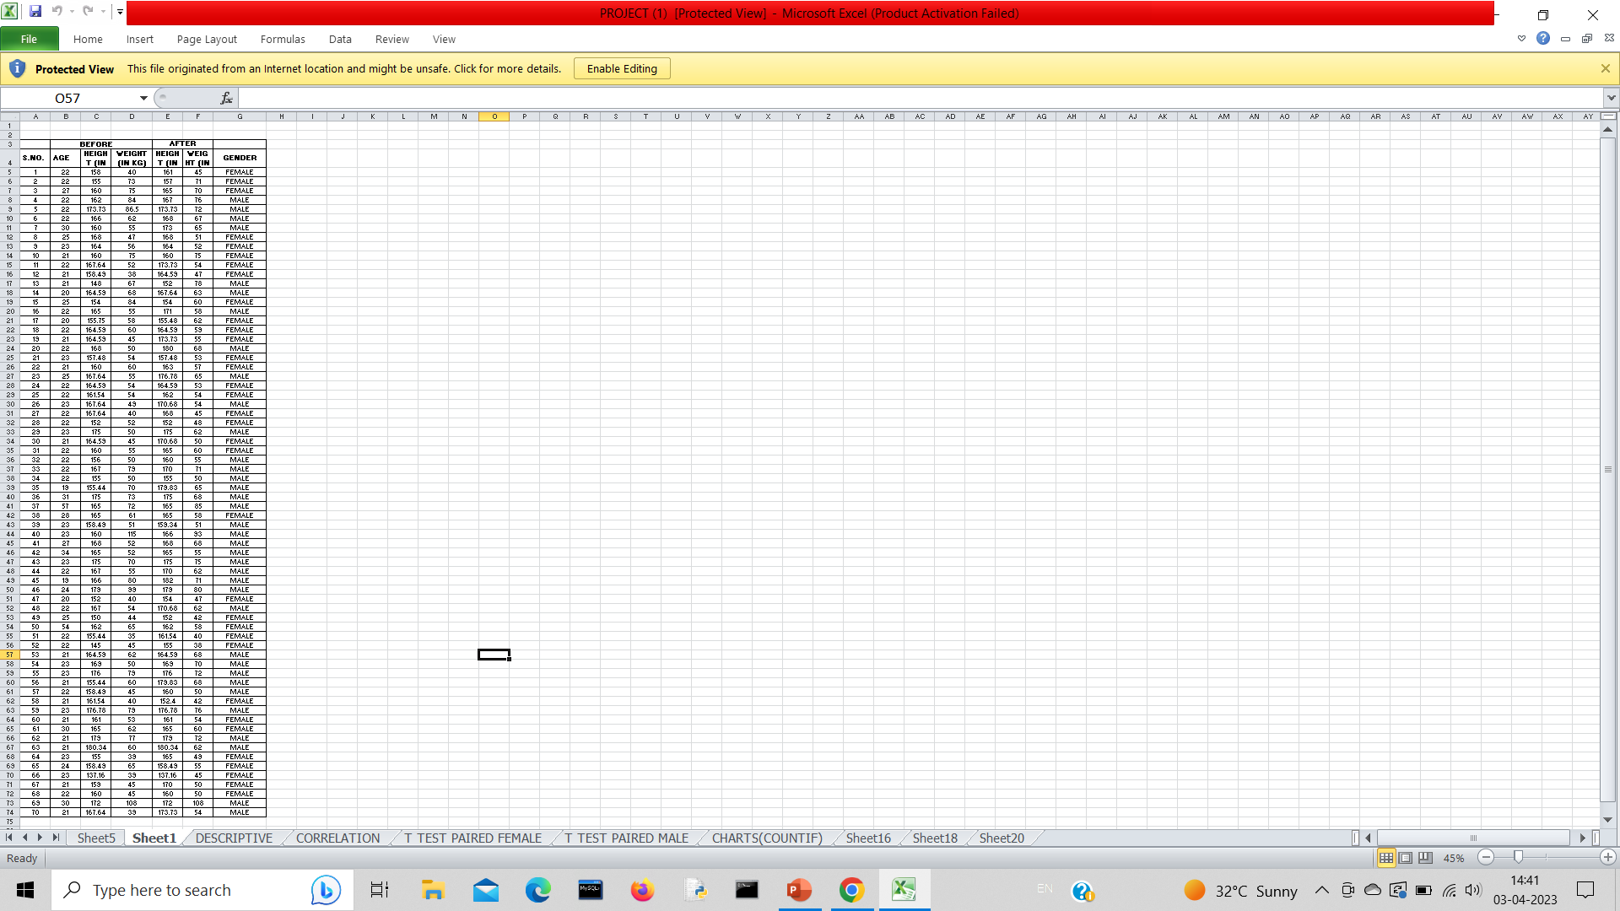

Slide 5
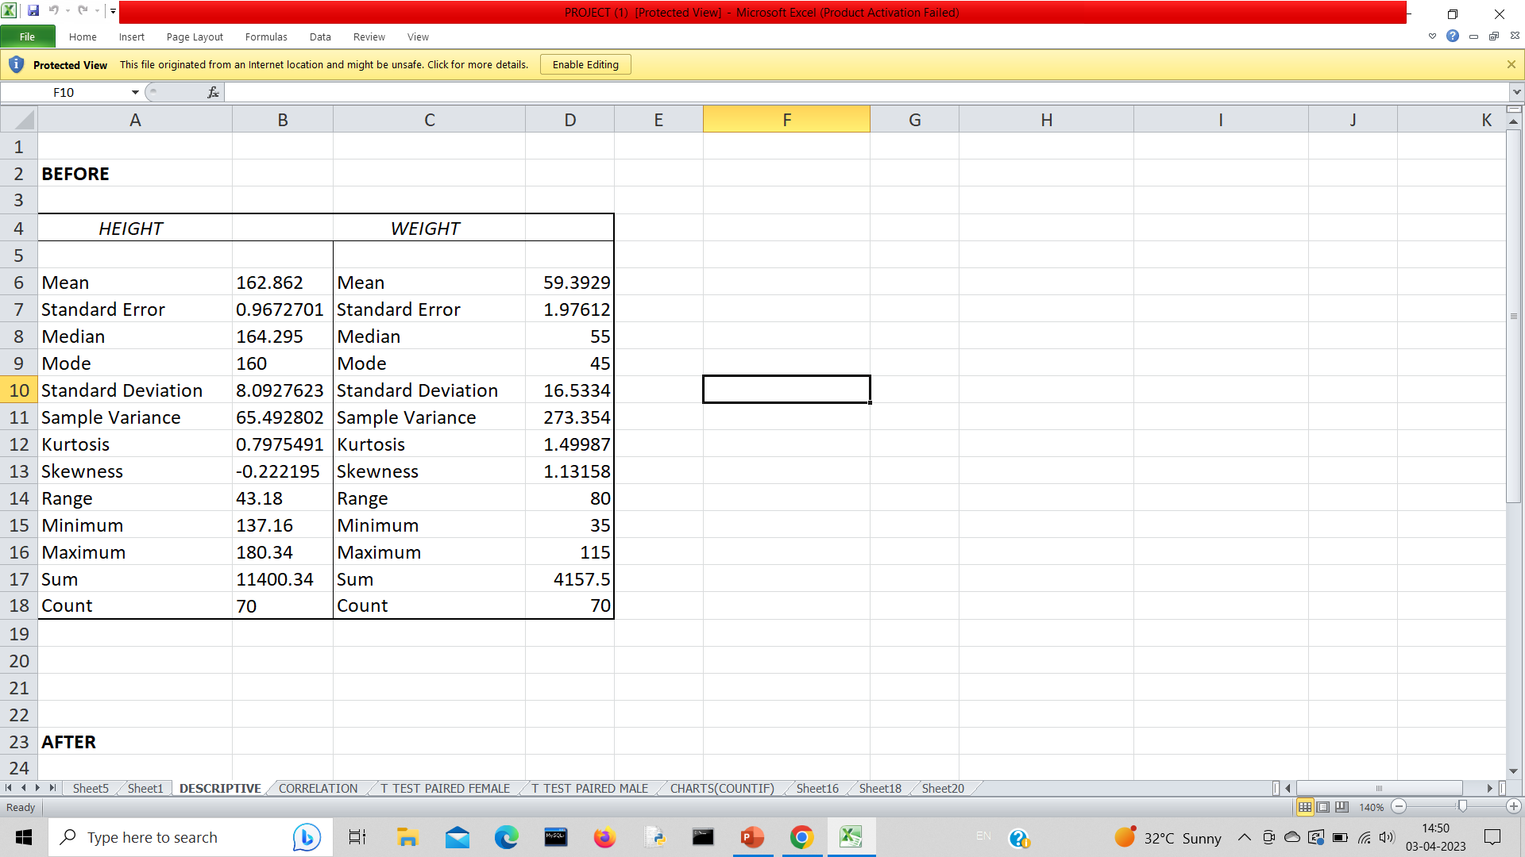
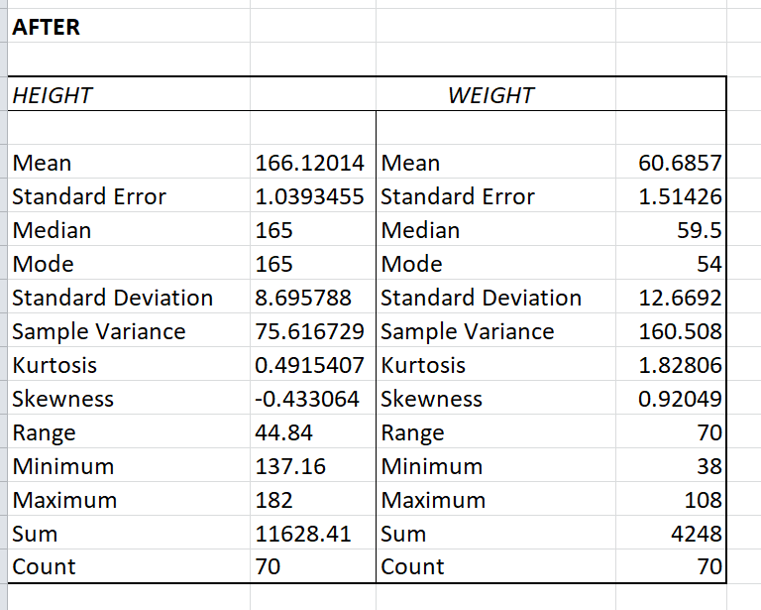
1. DESCRIPTIVE STATISTICS:

Slide 6
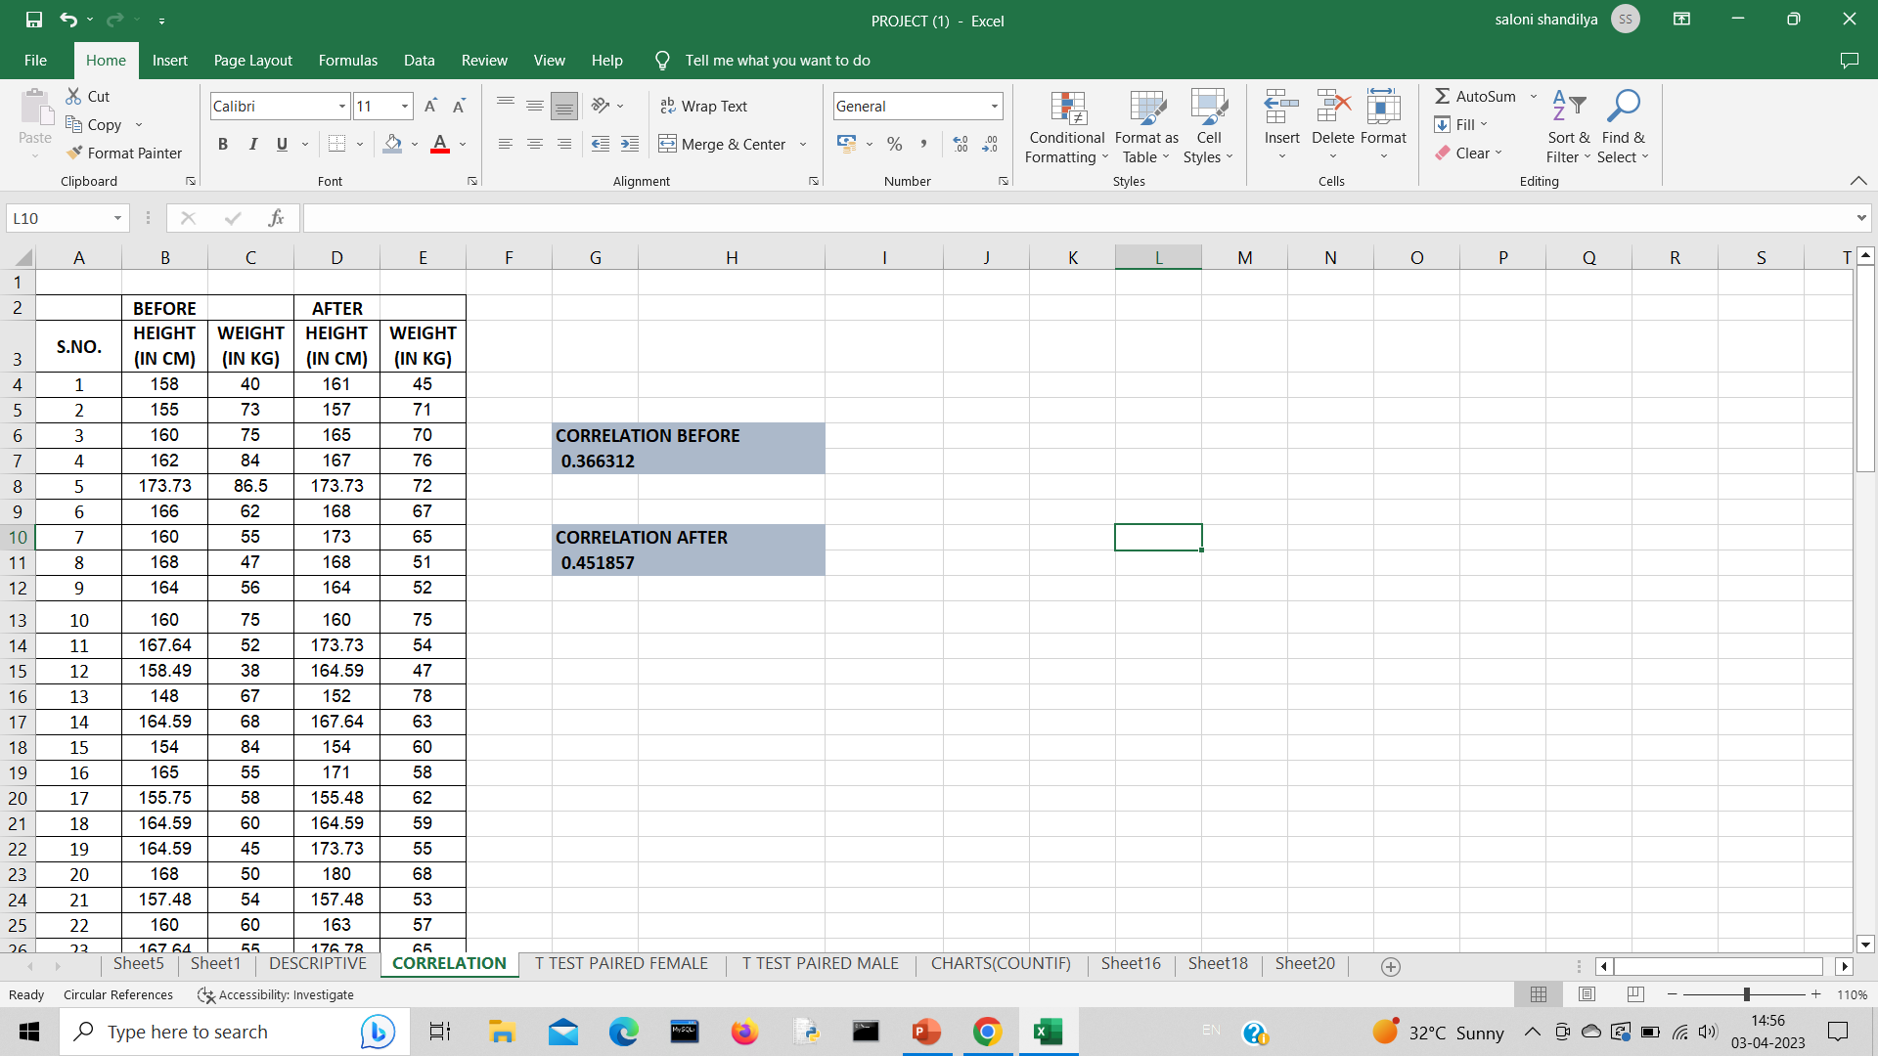
2. CORRELATION:

Slide 7
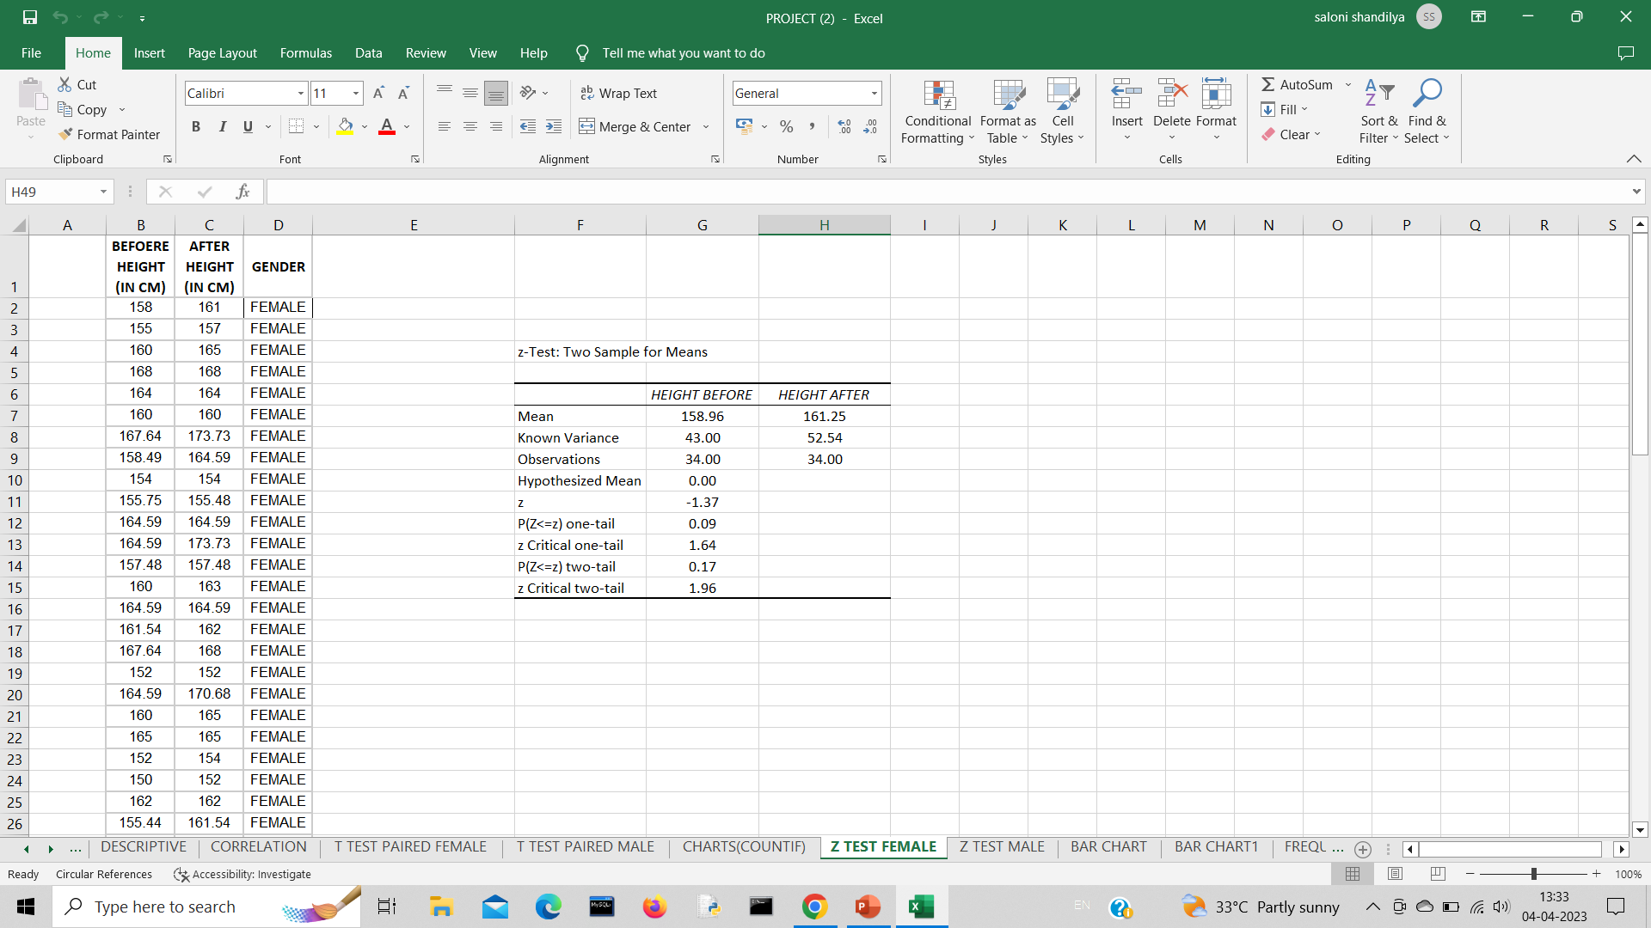

3. Z-TEST: TWO SAMPLE FOR MEANS
FEMALE (HEIGHT)

Slide 8
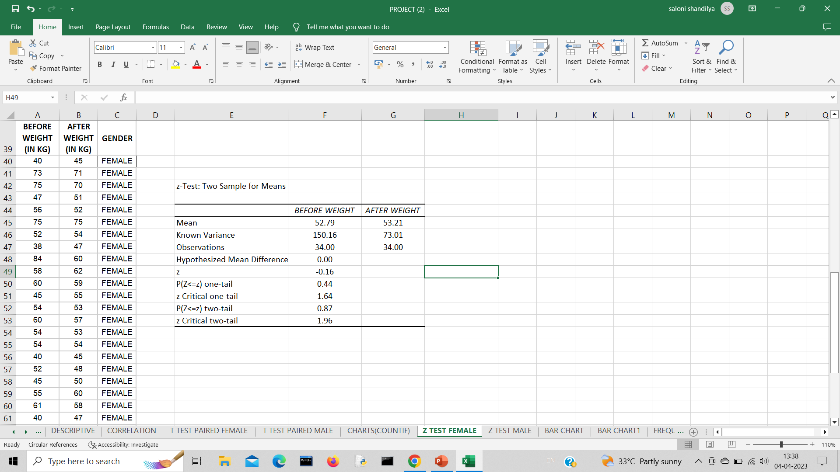
FEMALE WEIGHT

Slide 9
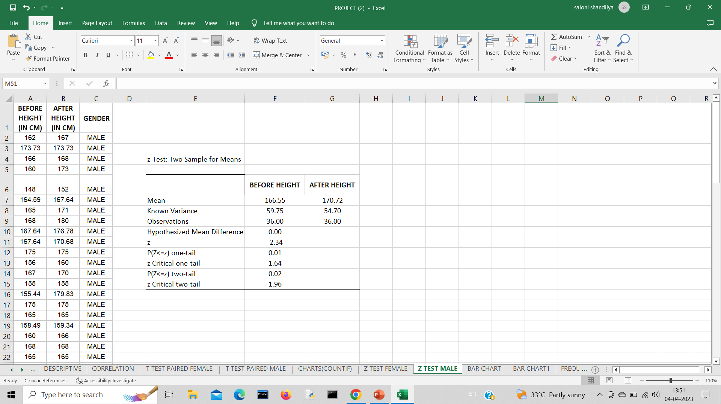
MALE HEIGHT

Slide 10
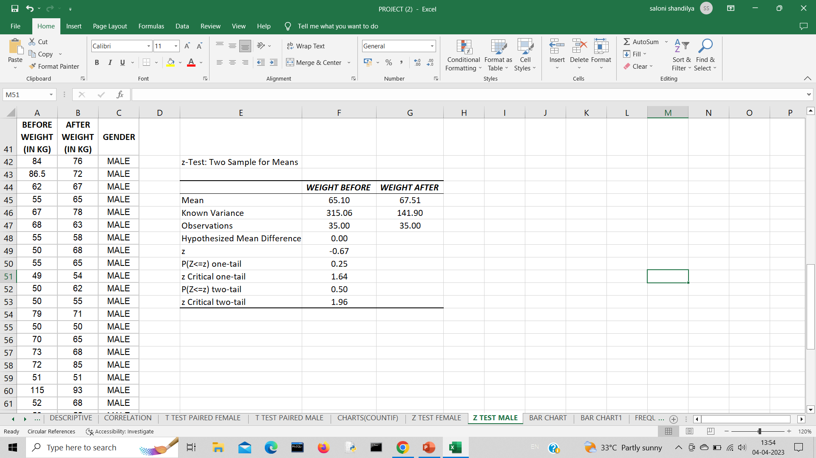
MALE WEIGHT

Slide 11
4. CHARTS
FREQUENCY FUNCTION
COUNTIF FUNCTION

Slide 12
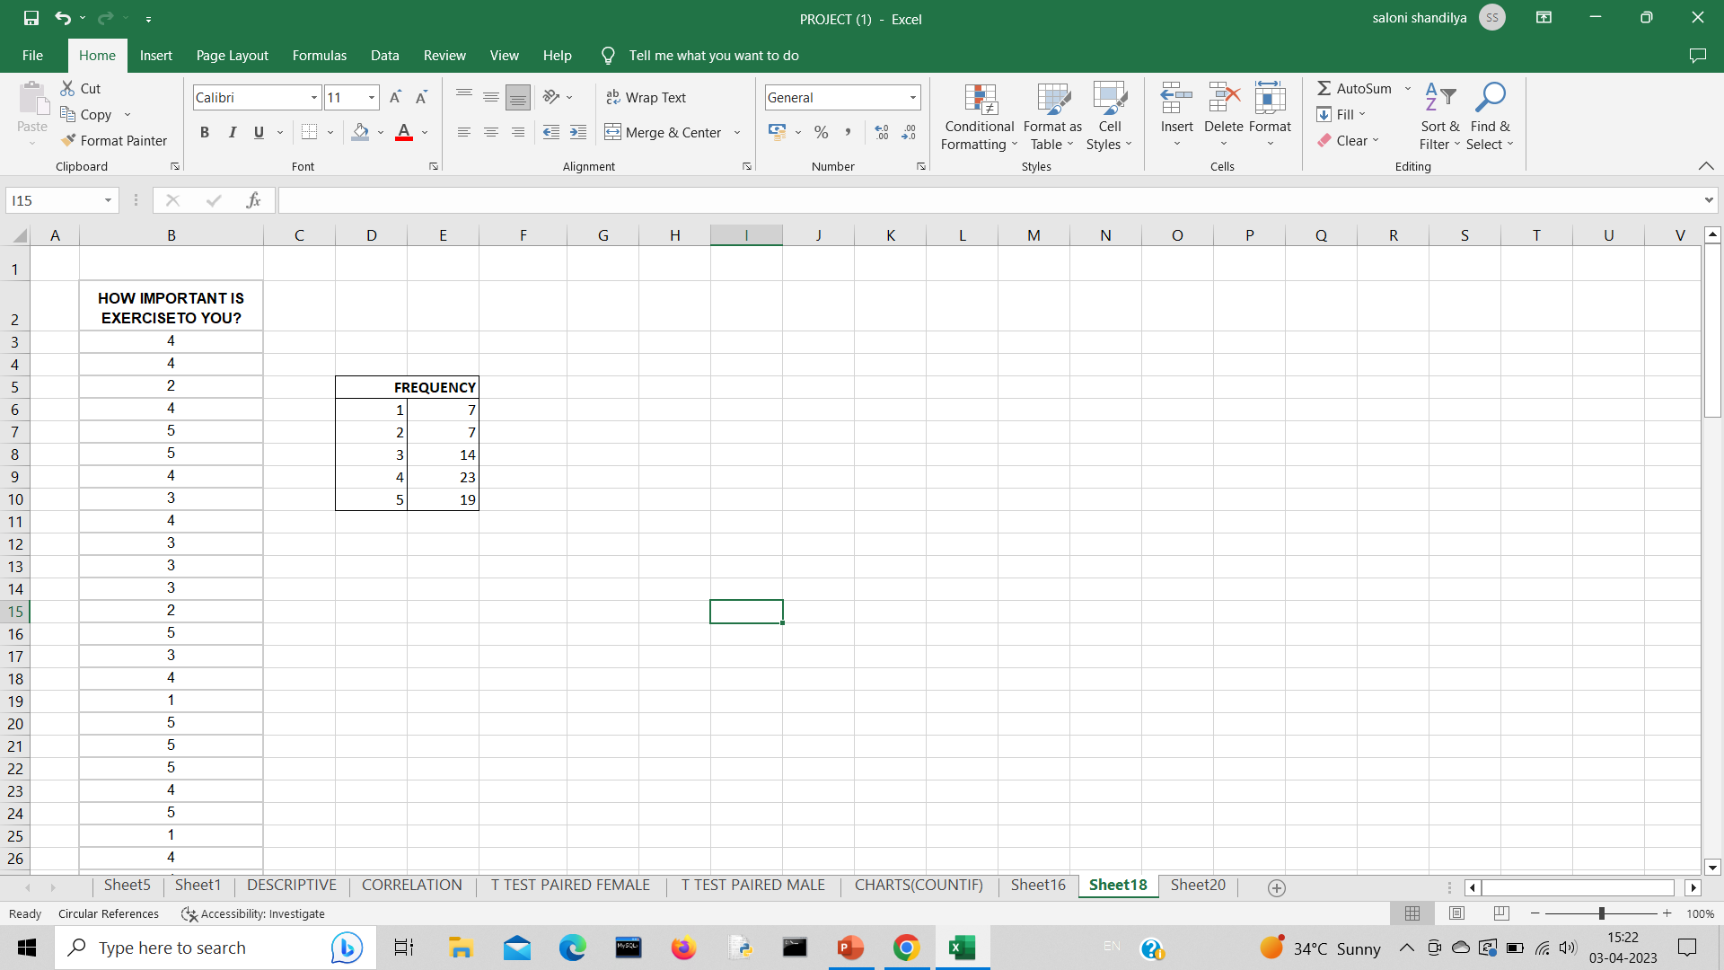
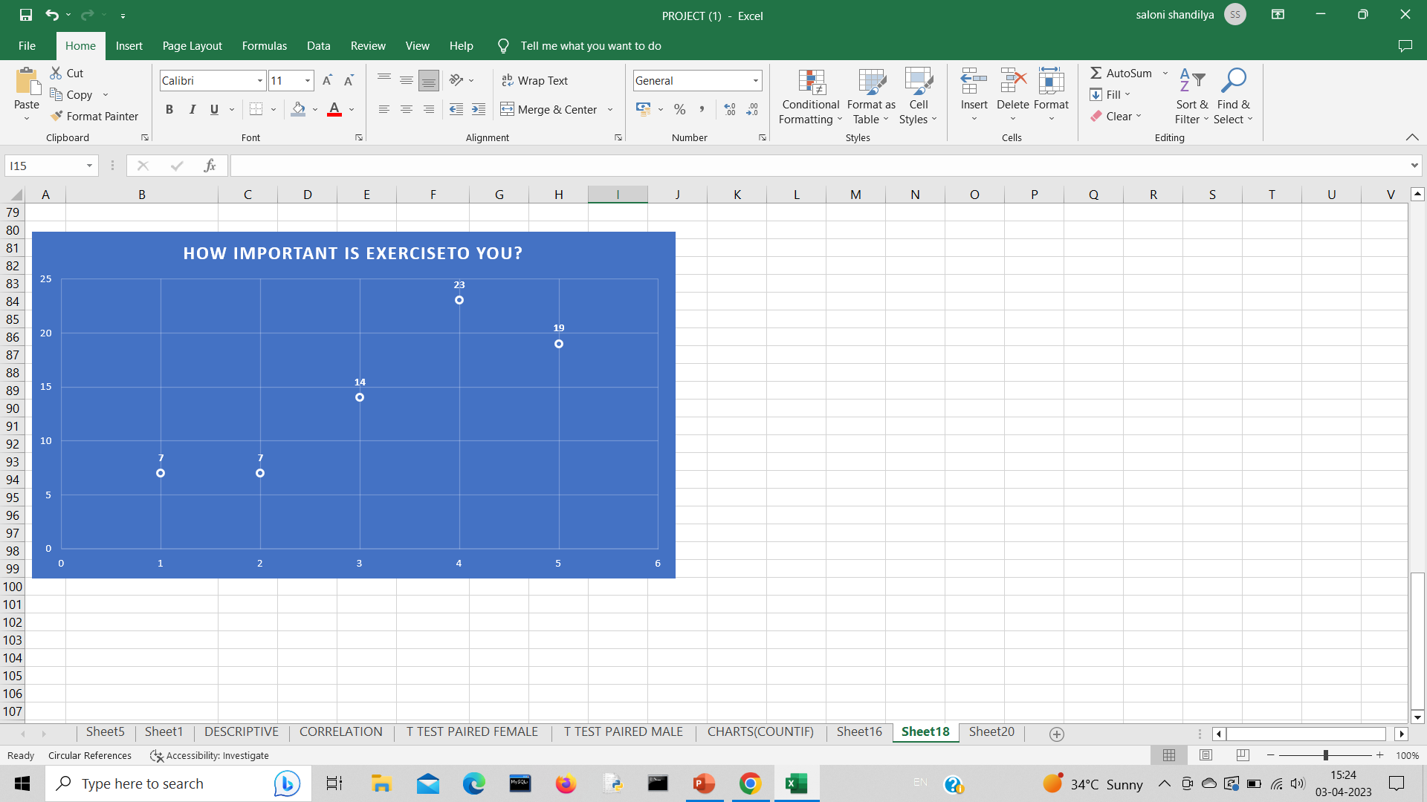
FREQUENCY FUNCTION

Slide 13
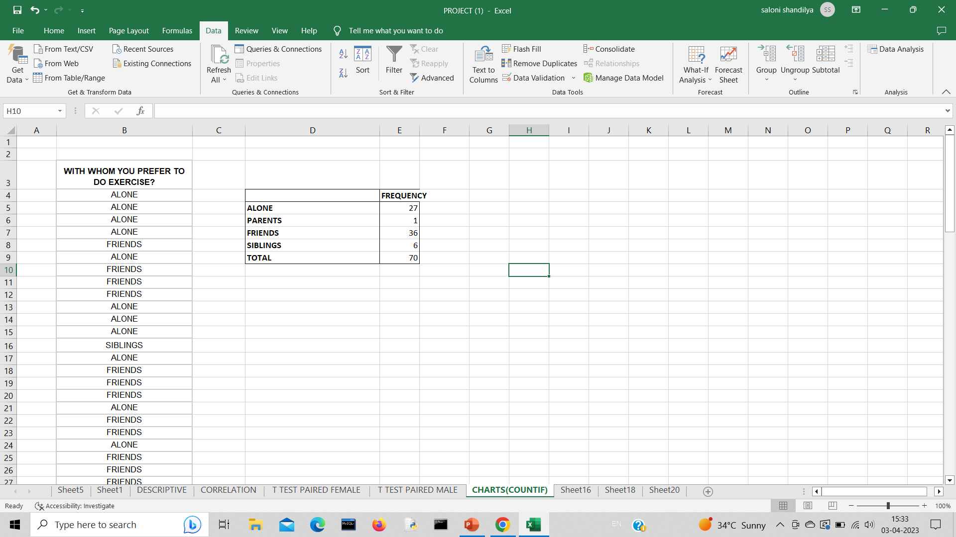
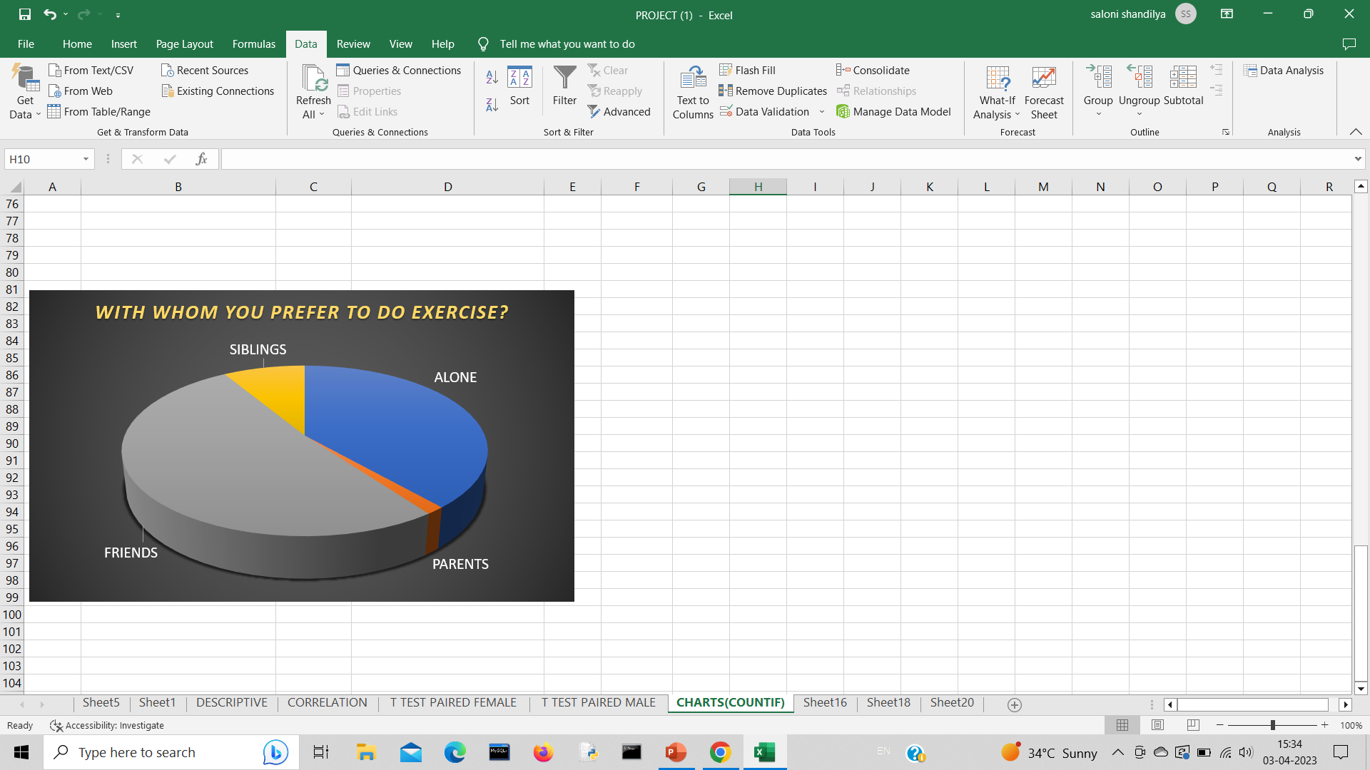
COUNTIF FUNCTION

Slide 14
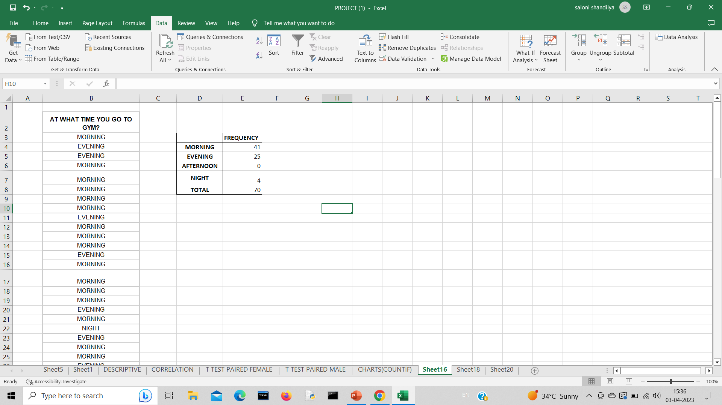
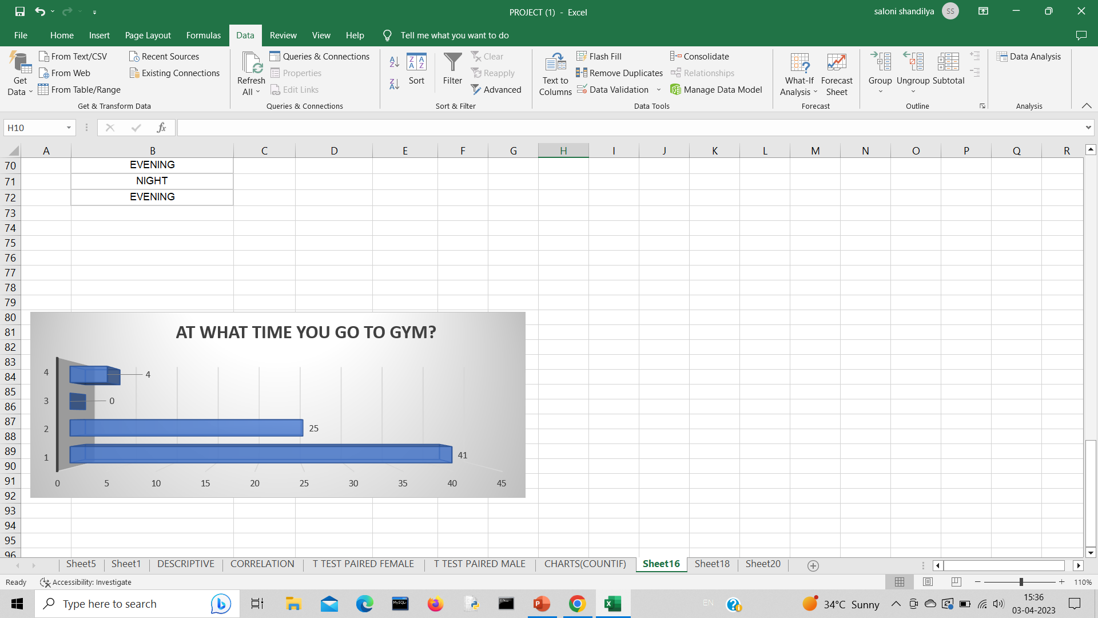

Slide 15
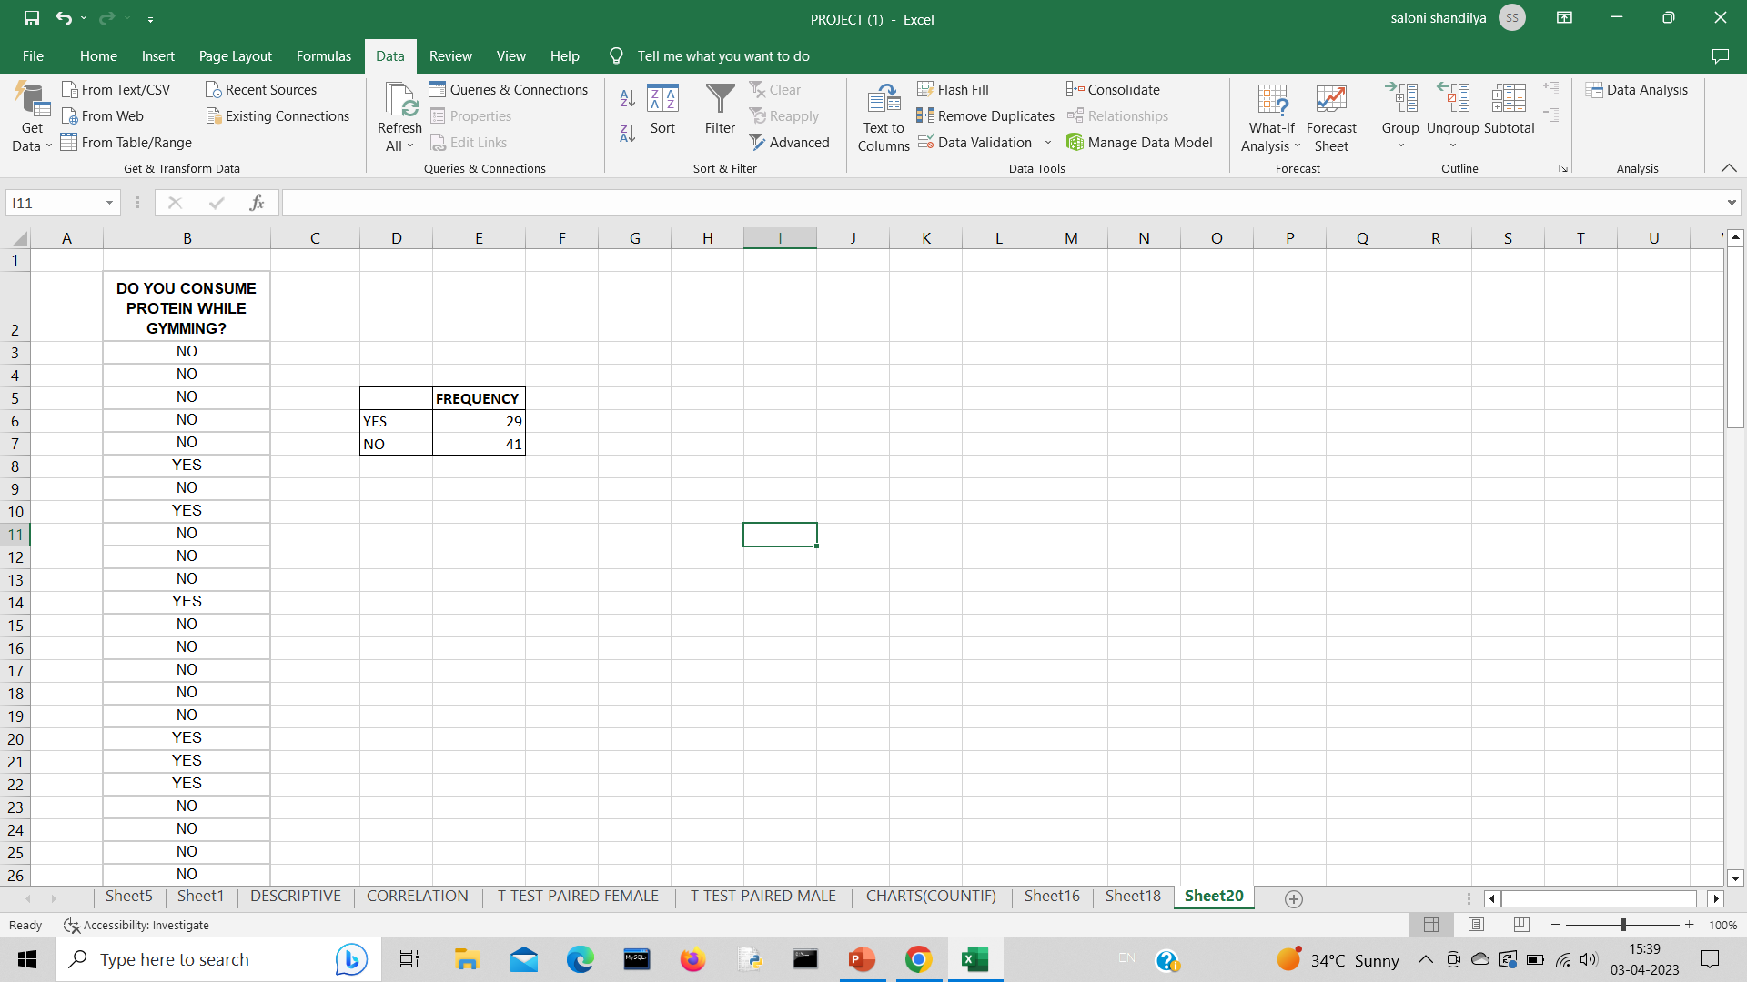
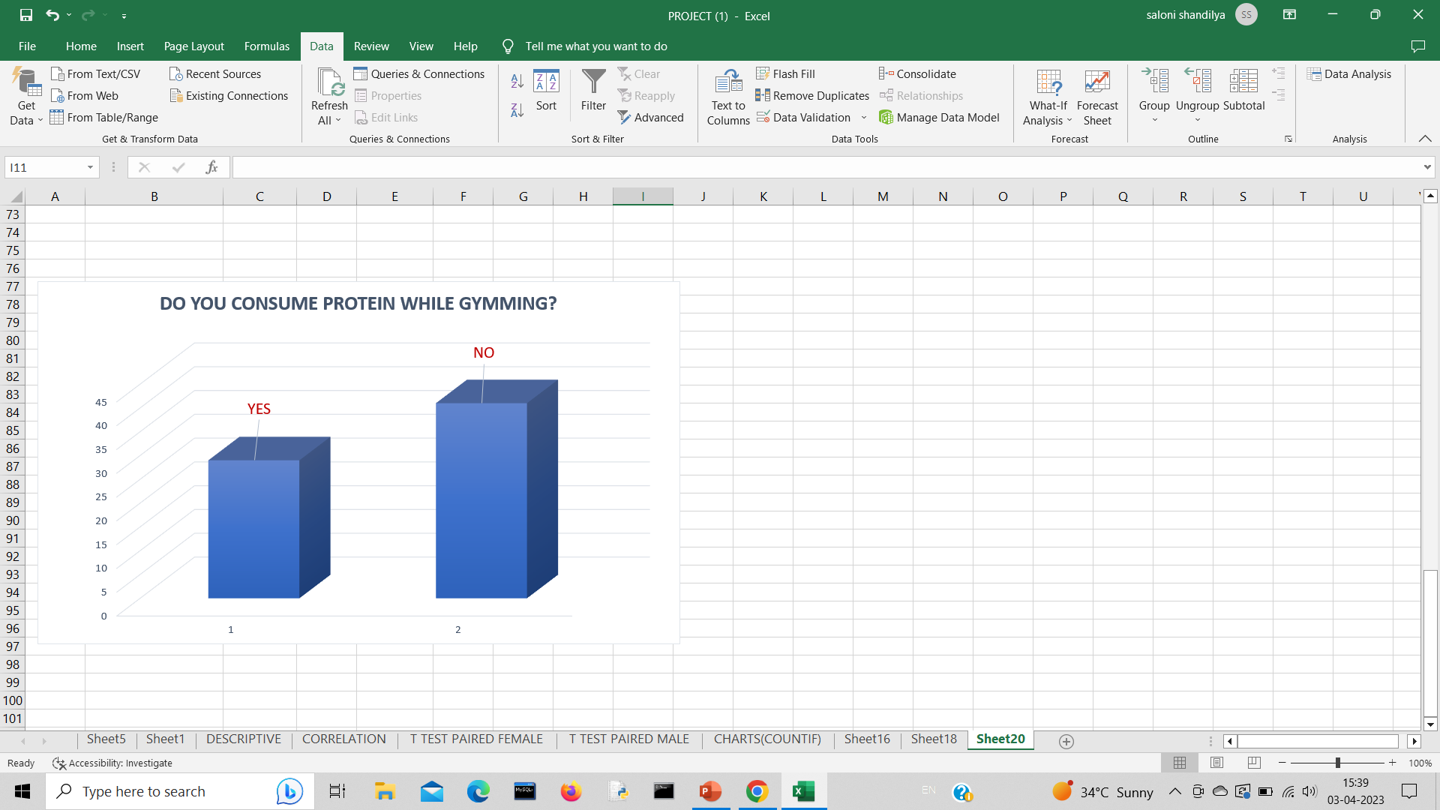

Slide 16


